Slide 1

ICUDDR Panel Presentation:
Next Generation of UPC Innovations for Broader Dissemination
4th Annual ICUDDR Conference
July, 2019
Presenters: Richard Spoth, William Crano, Kris Bosworth (Zili Sloboda)
Discussants: Fernando Salazar, Zili Sloboda

Slide 2

Background for Panel Presentation: Steps Toward Broader UPC Dissemination
  UPC Coordinator and Implementer Series completed
  UPC Pilots conducted in multiple regions of the world
  North American (NA) Region Steering Committee develops logic model for dissemination
  Complete deliverables for scope of work in CP contract, based on logic model
  UPC adaptation/dissemination work conducted, reported by this panel

Slide 3
Steps Toward Broader Dissemination of UPC in the NA Region: Using Existing Infrastructures and Systems as Platforms
Richard Spoth, PhD
F. Wendell Miller Scientist and Director, Partnerships in Prevention Science Institute, Iowa State University

Slide 4

A Vision for UPC Dissemination
Science with practice
  Envisioning large-scale training and transformation of addiction prevention workforces, guided by prevention science
  Harnessing the power of university networks applying addiction prevention science
One way to realize vision—Build on existing dissemination platforms
One type of dissemination platform—University outreach systems supporting community-university partnerships

Slide 5
Logic Model Approach to Vision/Mission, Action Plan Highlights
Inputs | Phase I Outputs |  | *Intended Outcomes
 | Activities | Results | Short-Term | Intermediate | Long-Term
1. Conduct Consumer Research and Market Analyses
Identify potential UPC Education Providers (EPs) of four types
Professional organizations
Universities (both enrolled and non-traditional students)
Governmental agencies
Non-governmental employers of service providers
Conduct research on EP preferences on training format and content
1. More effective procedures for recruiting, selecting, and evaluating prospective EPs
1. *Increased readiness for implementation of plan for UPC scale up with four EP types
* Intermediate outcomes contingent on UPC scale up plan development/ effectiveness
Existing UPC training materials
Expertise of NA Region steering committee/other university representatives
Funding from INL/CP/other sources
In-kind support from UPC developer universities
Expertise, funding, in-kind supports from international partners/ stakeholders– including INL, CP-ICCE, ISSUP, PEAG
Existing evidence-based interventions (EBIs-programs, practices, policies)
Existing education, health, social service infrastructures
Regulations concerning credentialing of prevention professionals
1. Increased quality
implementation and sustainability of evidence-based preventive interventions in the NA Region through an expanded, well-trained workforce
2. Increased number of trainees/ students/TOTs; increased offerings of training events and courses
Increased UPC reach at community, state/province, and national levels
2. Develop marketing approach for increasing reach to potential EP types
Marketing materials, including core/systems training options
Marketing strategies for specific audience segments
2. Marketing plans, materials and strategies for perspective EPs/consumers:
Professional organizations staff
University educators
Governmental agency directors/staff
Non-governmental employers of service providers (e.g., hospitals)
2. Increased UPC training-related skills and knowledge among the regional prevention workforce members
3. Develop procedures for EP screening and “start-up”
Readiness assessments of potential EPs
Provider application materials
Introductory UPC materials for selected EPs, including credentialing summary
3. Increased trainees developing community implementation systems
2. Increased NA Region activities designed to expand the workforce for prevention implementation systems
4. Conduct Initial Trainings with both UPC-C and UPC-I series for EPs
Standard in-person trainings/summer training institutes
Online/blended learning delivery modalities
Emerging Leadership Trainer of Trainer (TOT) model
3. Expanded EP-connected prevention workforce support for community implementation systems
3. More EPs submitting UPC Request Forms and signing UPC Agreements
4. Increased number of prevention professionals taking credentialing exams
5. Develop data collection capacities- data procedures and systems that build on ISSUP foundation for tracking UPC trainees, credentialing, EPs
5. Increased numbers of professionals participating in ISSUP network
4. Increased networking among prevention professionals
6. Evaluate EP and consumer response in person, online, institute training procedures– incorporate findings into UPC revisions
4. *Pilot evaluation findings applicable to UPC scale up plan development for four types of EPs
*Especially in the case of intermediate and long-term goals/outcomes, achieving them will require the development and implementation of a UPC scale up plan guided by Phase 1 results.

Slide 6

Central to this Vision: Workforce Training Development Network Planning
Illustrative Action Steps From Plan Based on Logic Model
-Organize state management committees
-Tie into workforce needs assessments (e.g., by public health departments)
-Develop multi-year plan for UPC dissemination projects to leverage earlier pilot work

Slide 7
Illustration #1 —
PROSPERing Step-by-Step,
State-by-State (P2S)

Slide 8
Why Use Land-Grant University Extension Systems as a Platform?
  Existing Land Grant University outreach infrastructure, resources and capacity reaching all counties in all states
  New funding streams for Extension to address opioid and other substance misuse issues
  Recommendations include evidence-based interventions with embedded technical assistance systems and a national network to support them

Slide 9
Land Grant University Workforce Training/Technical Assistance Model
National Network of Universities/Extension Systems
State Prevention Workforce Development Partnership
(PPSI, ISU/HSEO, U-TuRN and State Partners)
County-Level Teams
Coordinating Science-based Trainings
For Implementation of Evidence-Based Preventive Interventions
Training/TA Teams at State Regional Level
Linking Counties to State Management Team and State-Level Training/TA Supports)
State Management Team
Coordinate Training/TA, in collaboration with the PPSI Coordinating Center and its UPC Partners [APSI])

Slide 10
Key Features of P2S Project
  A framework for university community partnership-based dissemination of evidence based prevention
  Purpose is to build capacity within Extension systems to support state scale up and expansion of PROSPER partnerships
  Embeds UPC trainings in 2nd year, after PROSPER-type partnership is mobilized and core programs implemented

Slide 11
What Is the Rationale for P2S?
  Need to select effective/cost-efficient prevention programs that:
  Promote positive youth development
  Enhance family relationships
  Reduce youth risk for substance misuse/problem behaviors
  Need for quality, sustained program delivery to achieve long-term impacts for youth, families, and communities
  The addiction crisis, particularly opioids

Slide 12
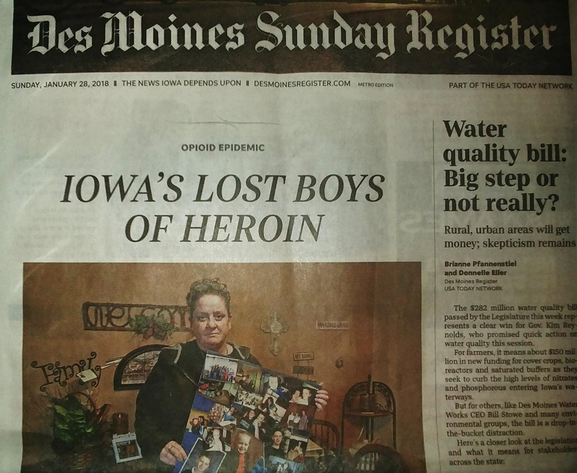
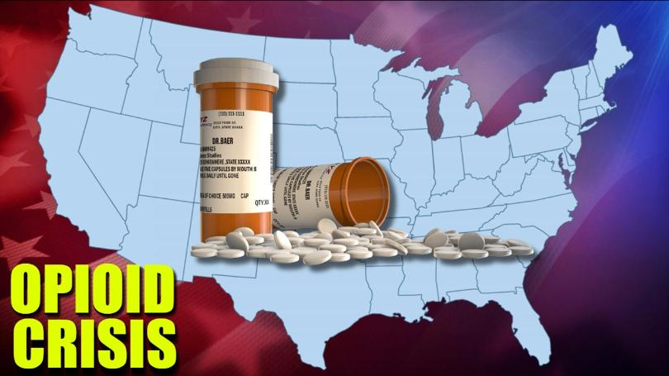

Slide 13
What are the Phases, Steps, Objectives and Activities for the P2S Project?
Multiphased PROSPER Partnership Model (PPM) Development Process
Mobilization/ Initial Ongoing Long-Term
Organization Operations Operations Sustainability
P2S Steps Corresponding to Multiphased PPM Process
Step 1
Step 2
Step 3
Step 4
Step 5
Mobilize/Organize
Train for P2S Implementation
Conduct Core Programming
Programming Capacity Building
Sustainability/
Capacity-Building for Expansion
P2S Awareness Building
County-Site Selection (Early Adopters)
T/TA Staff Start Ups
County-Level Trainings
County-Level P2S Awareness Building & Educational Events
County P2S T/TA Support
Resource/Capacity Building (Ongoing)
Implementation of Programming/ Activities
Tailored TA to Guide Implementation
Maintenance of Core Programming
Assess Readiness for Expanded Training/
Programming
Expanded Training Conducted
Sustainability Plan Development for State
Sustainability Plan for Early-Adopter Counties
TOT for Late- Adopter Counties
Substance Demand
Substance Availability

Slide 14
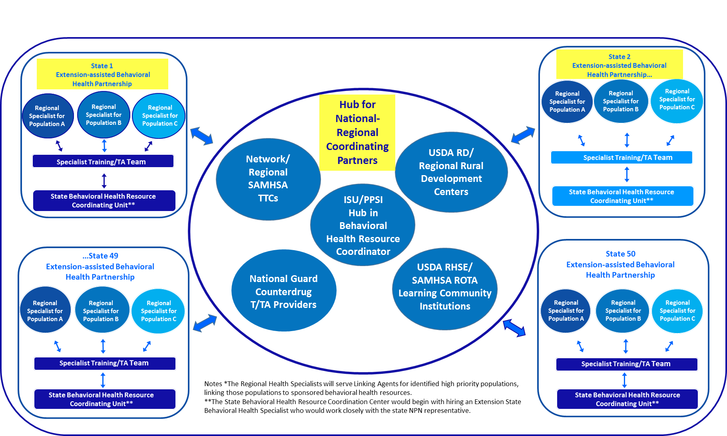
Illustration #2 —
The National Behavioral Health
Extension Network (NBH E-Net)

Slide 15

National Behavioral Health Extension Network (NBH E-Net) Purpose
To improve community prosperity and quality of life by increasing access to proven programs and services designed to enhance youth and family behavioral health and to prevent substance misuse.

Slide 16

NBH E-Net Developmental Phases
Phase 1 (Summer/Fall 2018):
  Secure core project funding through new demonstration grants
    Build on PROSPER Partnership Model program of research
    Learn more re PROSPER scale up strategies, addressing emerging addiction issues
  In 2018 received > $2.8 M (4 grants) for this Phase
Phase 2 (2019-20):
  In 2019 secured $100,000 for Initial Network Organization
  Planning on organizing state Behavioral Health Resource Coordination Units that facilitate UPC dissemination

Slide 17
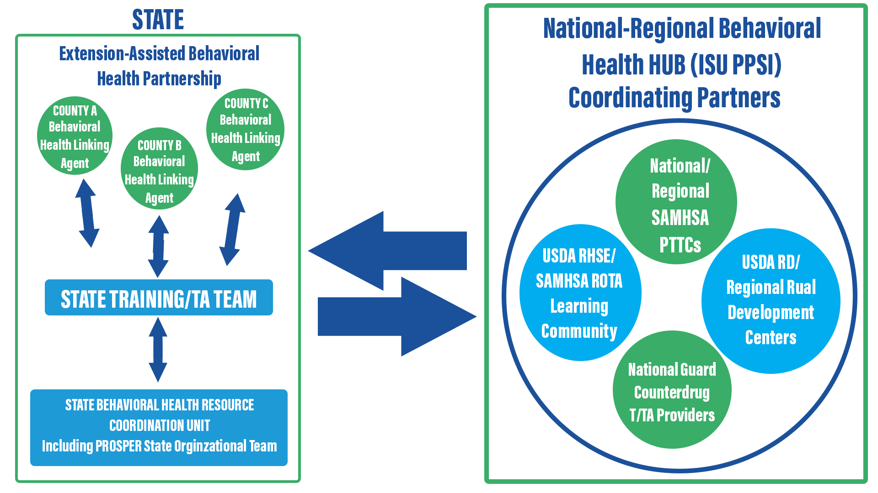
NBH E-Net: Initial Network Organization
NATIONAL LEVEL
STATE
National-Regional Behavioral Health HUB (ISU PPSI) Coordinating Partners
National-Regional Behavioral Health HUB (ISU PPSI) Coordinating Partners
National-Regional Behavioral Health HUB (ISU PPSI) Coordinating Partners
Extension-Assisted Behavioral Health Partnership
Extension-Assisted Behavioral Health Partnership
Extension-Assisted Behavioral Health Partnership

Slide 18
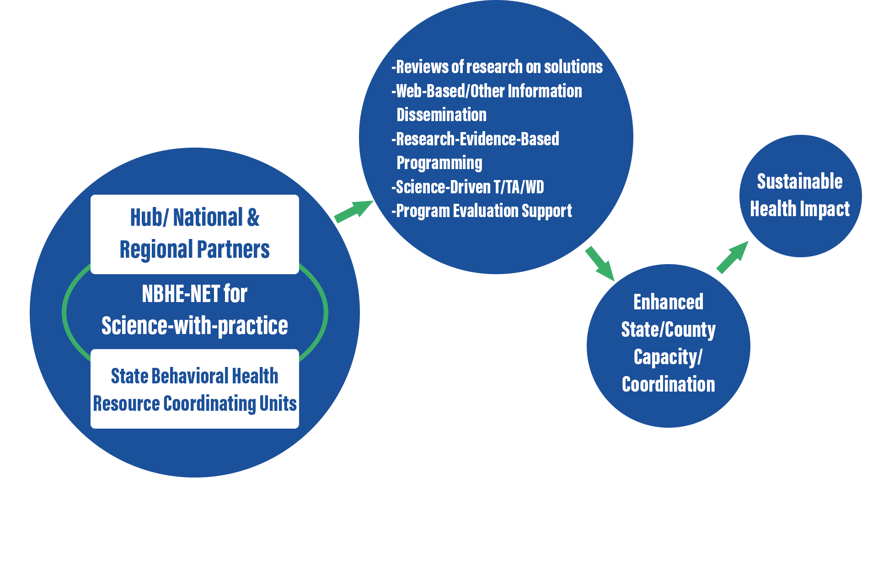
NBH E-Net: A Illustrative Framework for Capacity-Building Systems to Combat the Addiction Crisis
Source: Adapted from Brennan, Spoth & Skidmore 2018

Slide 19


Slide 20

Paper 2: Claremont’s Certificate Program for the Advanced Study of Media-Based Prevention Science
William D. Crano, PhD
Oskamp Professor and Director
Health Psychology and Prevention Science Institute
Claremont Graduate University
Claremont, California

Slide 21
Claremont Graduate University offers
A certificate program for advanced study of Media-Based Prevention Science, with
intimate-scale cohorts with a very favorable faculty-to-trainee ratio.
Participants build their knowledge and skills in using media to prevent psychotropic substance use
Advanced methodologies based on evidence-based persuasion models, using the media to enhance prevention effects, and the intersection of prevention science theory and research, along with on-the-ground practice are featured
The program culminates with a practicum experience tailored to current practice or needs of each trainee, designed to create a persuasive prevention campaign to be implemented as soon as the trainee returns home

Slide 22
The program has been designed to cover six key areas of Media-Based Prevention Science:
Introduction to media and their use in substance use prevention
The nature of the media and theories of media effects
Practical application of theories of persuasion in substance use prevention
Improving the impact of media-based substance use prevention campaigns
Introduction to monitoring and evaluation applied to media campaigns
Practicum: Developing a customized prevention campaign for immediate implementation

Slide 23
Phase 1 - All participants complete:
On Campus-Core Courses: The program begins with In-depth, rigorous learning with a series of three graduate-level core courses taught at Claremont’s campus in southern California:
  Theories of Health Behavior
  Survey of Prevention Science (based on UPC Core)
  Applied Attitude Change, Communication, and Persuasion
Notes:
Our Professors are experts in the field of Prevention Science and Health Psychology. Teaching Fellows will assist in class and also during the time participants are in their home locations working on assignments.

Slide 24
Phase 2: Distance Learning Component:
Takes place at the participant’s home base
Facilitated by Claremont teaching faculty
Using UPC-Implementers Media Prevention Track
90 hours of self-directed/guided computer-based learning
Culminates with each trainee developing a media-based prevention campaign that is culturally appropriate for immediate implementation in his/her home country.

Slide 25
Phase 3: Practicum
Week-long Practicum Capstone guided by faculty of CGU’s Health Psychology and Prevention Science Institute on Claremont’s campus
All competency areas in Media-Based Prevention Science are addressed
Final review of content and completion of final certification examination
The GOAL: Ensure that participants return to their homes with the knowledge necessary to create fully realized evidence-based prevention programs geared to the specific issues of concern in their countries
Ensure that participants can make an immediate and successful contribution to prevention needs in their respective countries

Slide 26
Steps to Program Implementation
Proposal
Department/Dean buy-in
Curriculum Committee
Provost
Accreditation (WASC)
Marketing and Recruitment
Admissions/Registrar
Housing, Food Service, Transportation, Entertainment

Slide 27
Participant Comments/Evaluation
The Media Based Substance Use Prevention Training made a huge impact to me as an employee and an individual. The knowledge I acquired helped me determine the common mistakes of substance use prevention and apply it to my work and at the same time share to my co-employees.
Before I attended the training, the educational materials I was using were mainly based on scare tactics (instilling fear in my audience) and information which in most cases wasn’t evidence based.
I have now come to realize people resist campaigns when they feel their freedom is being threatened and also messages based on scare tactics do not usually work.
The material was new to me and I will apply it to my work and I appreciate the teachings and my expectations were fulfilled and the course went above them.

Slide 28
Table 1.
Name(s) | Country | Campaign Focus | Theories/Concepts Applied
Hang Pham, Nguyen Chung, Nam Hoang | Vietnam | Methamphetamine use in adolescents | Theory of Planned Behavior and Reactance Theory
Liane Kalacas, Jose Patrick Madayag | Philippines | Drug education for security guards | Theory of Planned Behavior and the EQUIP model of message development
David Hutapea, Affan Budi | Indonesia | Mother-targeted substance use prevention campaign for adolescents | Misdirected messaging, Theory of Planned Behavior (Perceived Behavioral Control)
Rees Oduro, Gifty Annan, Shirley Annan | Ghana | Parent-targeted marijuana prevention campaign for adolescents | Misdirected messaging, Theory of Planned Behavior, Two-Step Flow Model
Phenyo Sebonego | Botswana | Driving under the influence prevention in youth (18 – 35 years old) | Theory of Planned Behavior, Two-Step Flow Model
Ofentse Rampete | Botswana | Parent-targeted tobacco prevention campaign for children under the age of 13 | Theory of Planned Behavior
Portia Diteko | Botswana | Excessive alcohol use prevention in youth ages 15 to 35 | Theory of Planned Behavior, Attitude Ambivalence, EQUIP model

Slide 29
Examples of Realized Media Campaigns
(Philippines) Campaign on drug education and prevention training for security guards applying the Theory of Planned Behavior and EQUIP Model (being implemented)
(Botswana) Excessive alcohol use prevention campaign targeted at youth at annual local music festival, applying Vested Interest Theory and the EQUIP Model (implemented)
(Ghana) Parent- and youth-targeted marijuana prevention campaign, guided by the Theory of Planned Behavior and EQUIP Model (under ministry review)

Slide 30
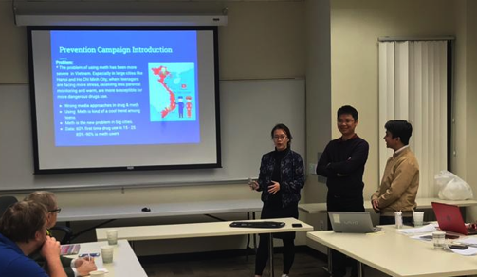
TEAM VIETNAM
Invited to make a presentation to government ministers and employees, substance use professionals, university faculty, and members of INL to share what they learned. They did a critique of the ministry’s recent campaign and told the audience how they should have done it the right way. The ministry was appreciative of the feedback
and is making changes as
we speak.

Slide 31
Lessons Learned
1. Maslow was right-
  Participants need to have basic needs met
    Luggage arrives
    Per diem ready on arrival
    Food available on arrival
    Good housing
2. Blended programs work
      In-class first sets standard of performance
      Technology mediated instruction allows intensive learning at a distance and develops group comraderie and Participants can be anywhere (with adequate WiFi bandwidth)
      Final week on campus great way to bring program full circle and celebrate/reinforce learning that occurred

Slide 32
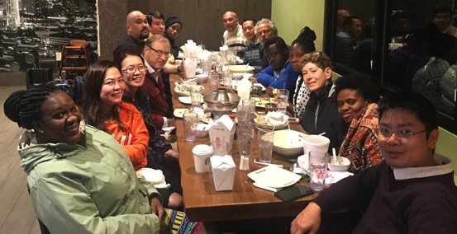
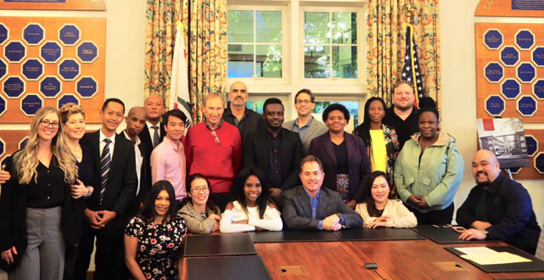
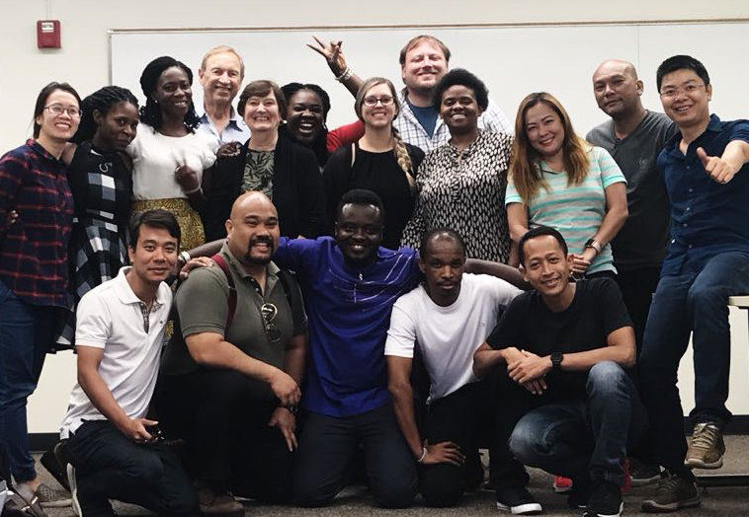
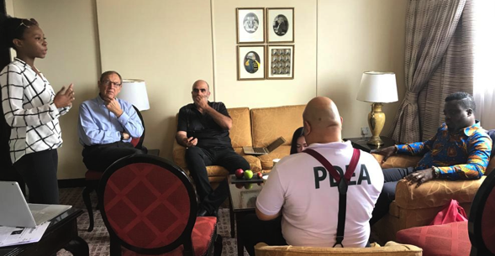
Lessons Learned (cont’d)
3. Intergroup Communication is essential
  Whats’App (group still going strong)
  After class activities, BBQ’s, music evenings, group dinners – many planned by the trainees– group cohesiveness

Slide 33
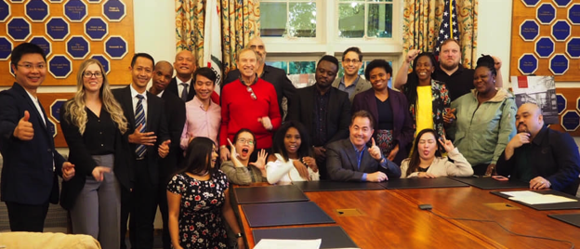
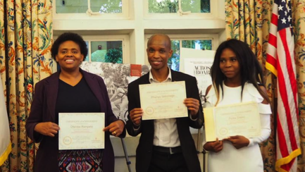
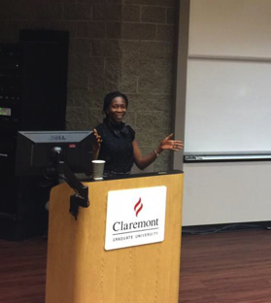
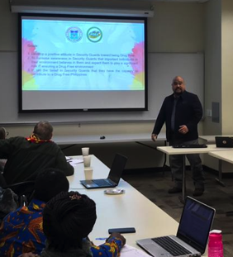
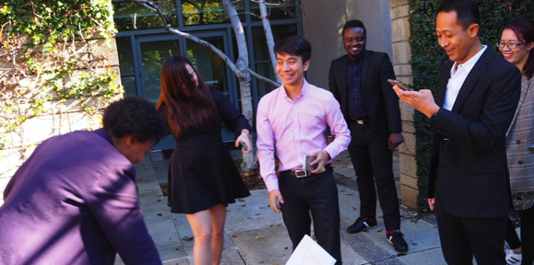
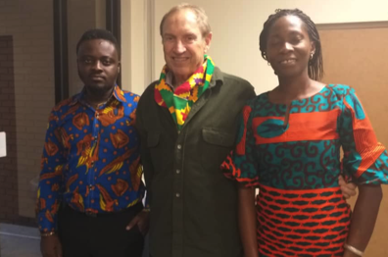
Thank you!

Slide 34
Paper 3: UPC SCHOOL TRACK
Expanding Audiences
Kris Bosworth, Ph.D. & Joyce Phelps, M.A.
ICUDDR Conference Peru 2019

Slide 35

Intended Audiences
COORDINATOR SERIES - Administrators/Decision makers/Policy makers
Professionals who have the power and authority to make decisions on programs or curriculum, allocation of resources or assignment of personnel in schools.
IMPLEMENTER SERIES – School Leaders/ teachers/Implementers/counselors
Educators who have direct contact with students to teach prevention curriculum or implement prevention policies.

Slide 36
School Track Courses
Coordinator Series
#1 – Training introduction
#2 – Schools are important settings for prevention
#3 – Child and adolescent development
#4 – Substance abuse problems defined
#5 – Applying prevention theory
#6 – Selecting the right prevention program
#7 – School environment and policies
#8 – Monitoring and evaluation
#9 – Applications to practice

Slide 37
School Track Courses
Implementer Series
#1 – Role of Schools in Prevention*+
#2 – Building Teams for School Prevention*
#3 – Creating School Policies*
#4 – Creating a School Prevention Climate*
#5 – Selecting Evidence-based Curricula/Programs*
#6 – Action Planning to Create a Comprehensive Prevention Initiative *
#7 - Positive Classroom Climate +
#8 - Interactive Teaching Skills +
+ = Teachers/Implementers * = Administrators/Decision Makers

Slide 38
Non-School Applications
Police
NGO’s
Court personnel
Religious groups
Youth organizations
Academics

Slide 39
General Changes
Greater awareness of the complexity of issues surrounding youth substance use.
Appreciation for the role of research
Embrace of less punitive approaches
More strength-based/public health approaches
Willingness to try new interventions
More research/fact orientation about substance use rather than moral approach
Commitment to working with other youth serving groups - networking

Slide 40
Examples from UPC Trainees

Slide 41
Regional Police Training
Ernesto is the director of the youth crimes unit of the regional police force.
His plan was to adapt the UPC information into the training he does for his unit.
His previous training focused on just information about what different drugs did to the body and on the laws regarding drug violations.
“Officers need to understand how complicated a problem this is and have more compassion in dealing with kid who are in the police system.”

Slide 42
Non-school Youth Programing From Ngo’s, Religious Groups and Other Youth Organizations
All three of these groups have programming for youth. Each identified how they could integrate either evidence-based practices or entire curriculum into their activities schedule.
Francisco (Youth conservation group) “Now, we only talk about drugs with the older teens. I see I need to be starting the conversations earlier.”
Manuel( Religious group) “We have had a lot of discussion about what to do with the youth on this topic. Now, I can find a curriculum that we can use with our children.”

Slide 43
Court System
Julia is a lawyer in the youth court system. She was vocal in championing a more wholistic approach to dealing with youth who are using substances.
“We have punished many kids who are not serious about using drugs. Our punishment pushes them in that direction. What I have learned is that there are other approaches. I don’t know if I can change the system, but I have some more information to try.”

Slide 44
Conclusions
The UPC School Track curriculum is flexible enough to be of use to non-school organizations who either
  Serve youth or
  Train professionals (police, teachers) who work with youth
Including participants from other youth serving organizations increases the networking possibilities to provide youth with consistent messaging about substance use.

